Slide 1
常見老年性眼部疾病
何宇光

Slide 2
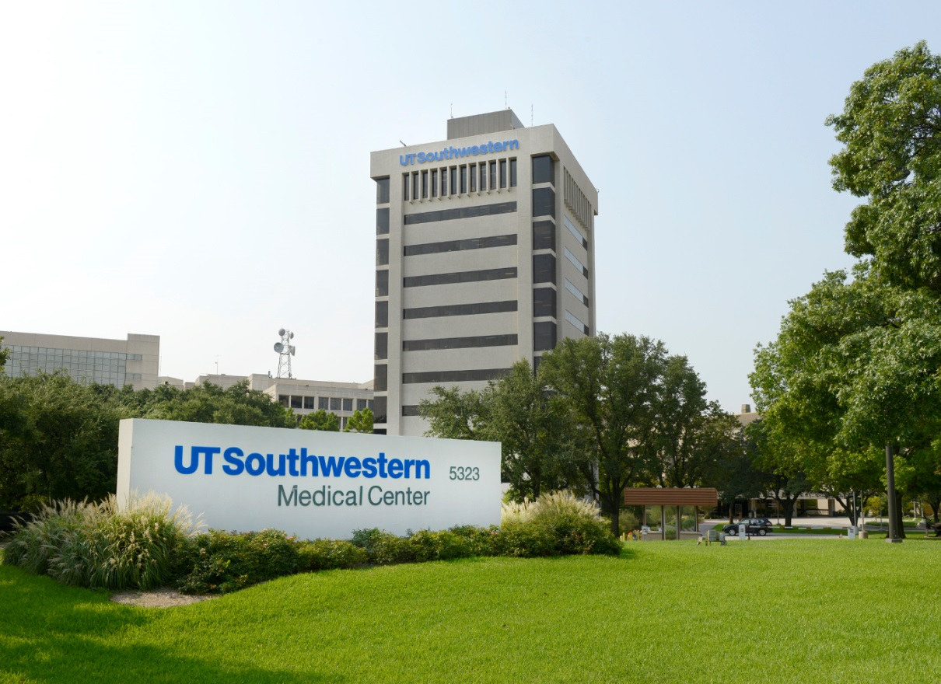

Slide 5
乾眼症
白內障
青光眼
黃斑病變
糖尿病眼底出血飛蚊症
飛蚊症

Slide 6
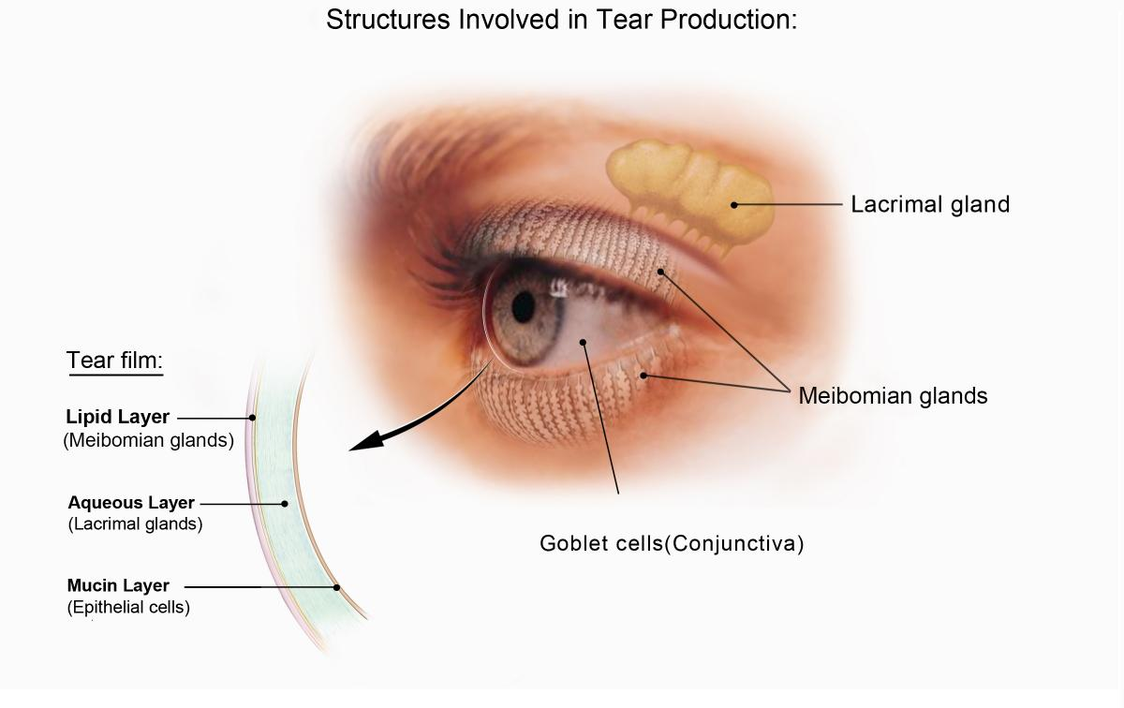
乾眼症

Slide 7
乾眼症：年龄相关

Slide 8
乾眼症： 治疗
人工泪液
手指按摩
泪道封闭手术
特殊药物 (Steroids, Restasis)
全身系统治疗

Slide 9
飛蚊症
玻璃体胶后脱离

Slide 10
Posterior Vitreous Detachment
Vitreous
Clear gel “white of and egg”
Fills the central cavity
Attach to the retina, esp.at the vitreous base, optic nerve , macula and the vessels
PVD
Most common
Age related liquefying process
Infrequently causes a problem

Slide 11
Symptoms of PVD
Floaters
Condensed collagen in the liquefied vitreous
Flashes and Floaters
Flashes of light (photopsias)are caused by the tugging of the vitreous on the retina

Slide 12
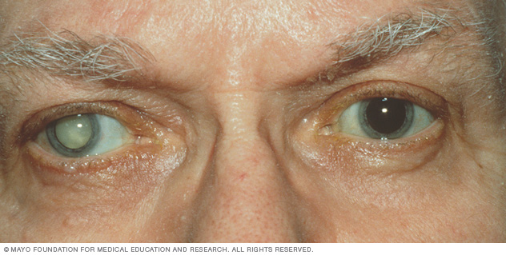
白內障

Slide 13
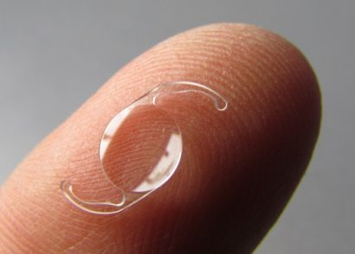
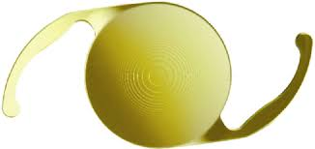
单焦，多焦人工晶体

Slide 14
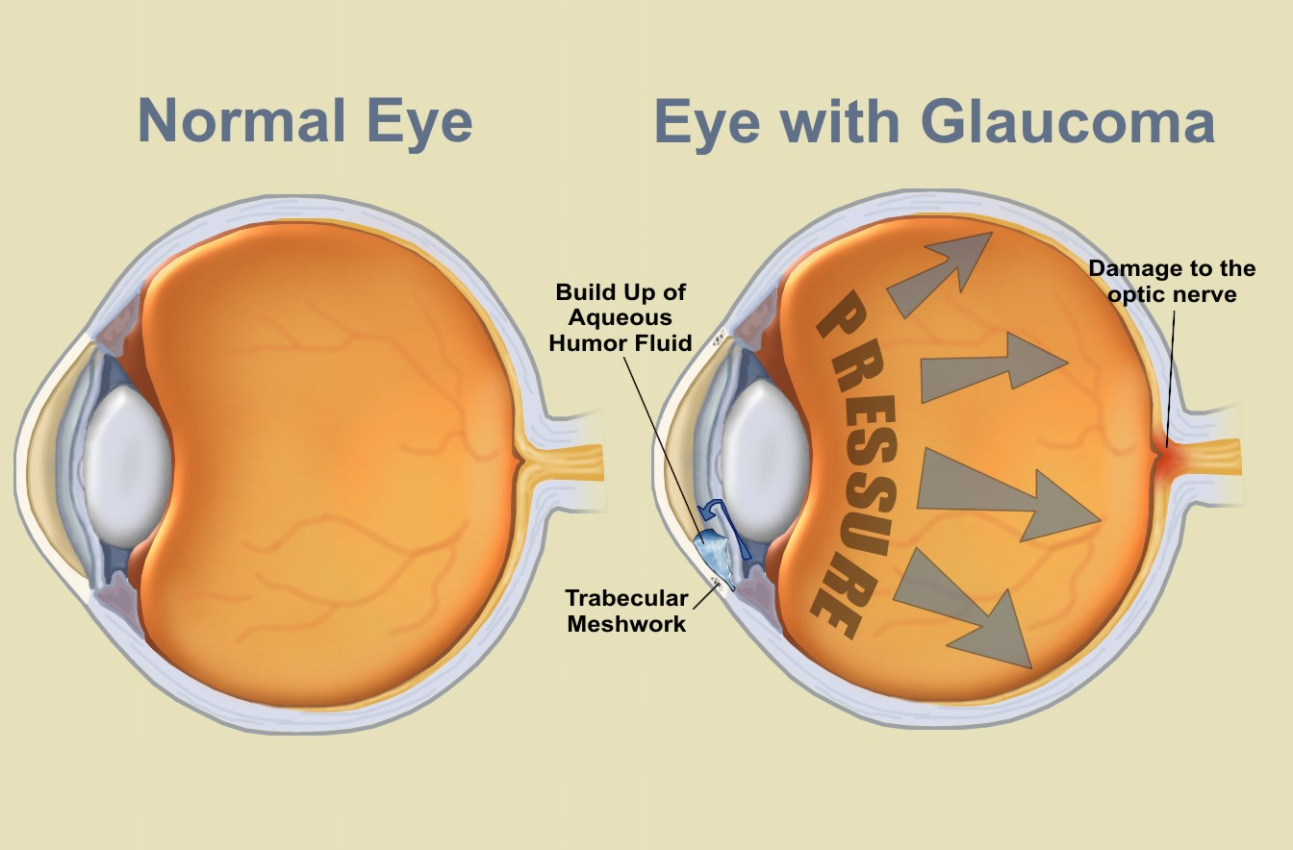
青光眼

Slide 15
青光眼的治疗
药物
激光
手术

Slide 16
黃斑病變
老年性黃斑變性 （乾性）（濕性）
黃斑水腫
黃斑裂孔

Slide 17
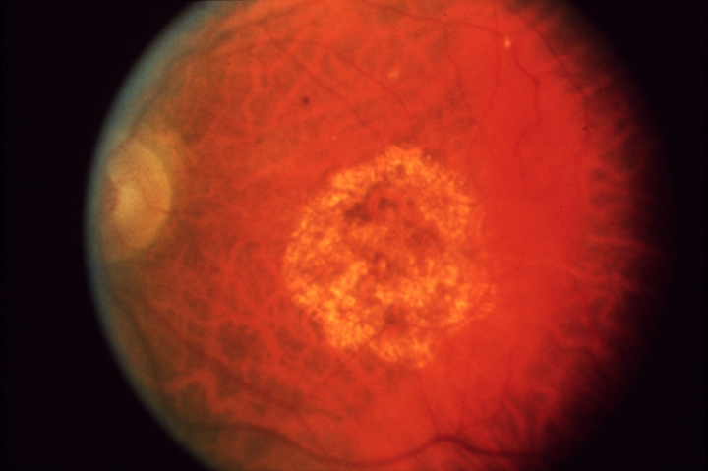
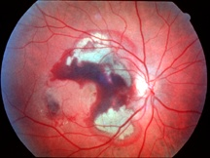

Slide 18
黃斑變性的治疗
乾性：
Eye vitamin
濕性
Injection of anti-VEGF
Laser

Slide 19
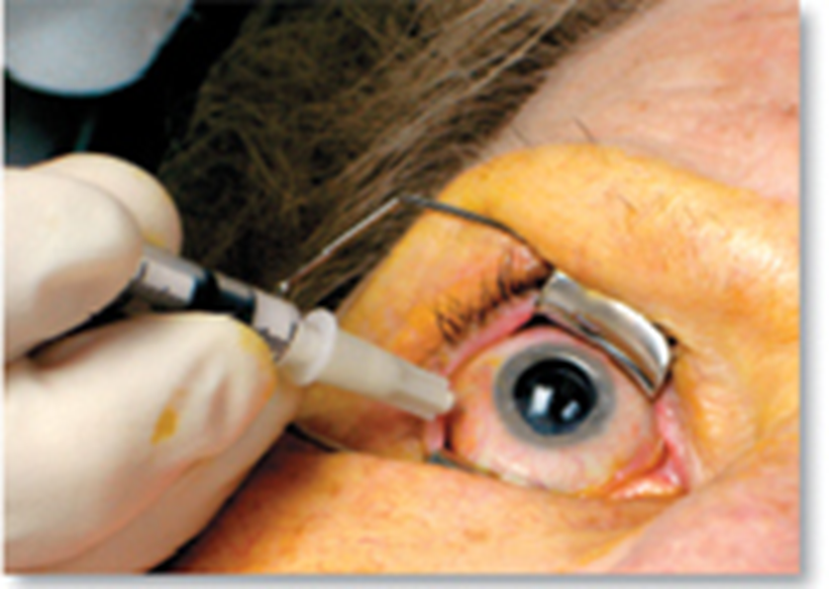

Slide 20
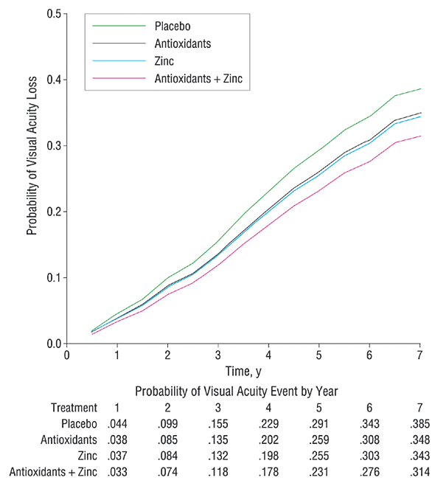
AREDS OUTCOMES
)

Slide 21
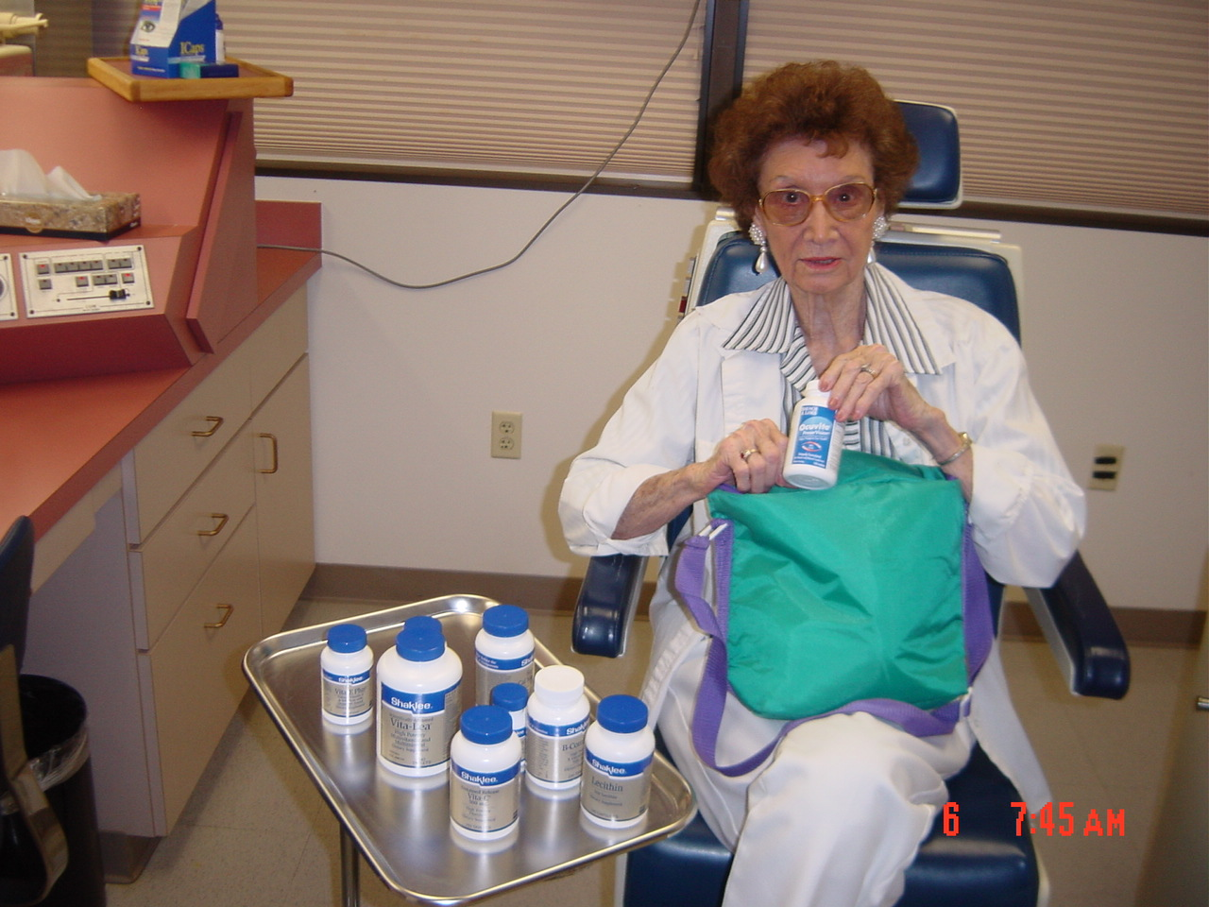
Doc, which vitamin should I take?

Slide 22
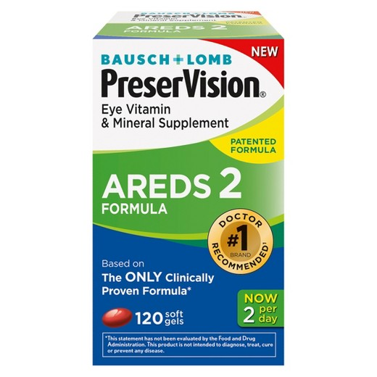
AREDS2, Eye Vitamin

Slide 23
What Vitamins in AREDS2
What 500 mg vitamin C.
400 IU vitamin E.
10 mg lutein.
2 mg zeaxanthin.
80 mg zinc.
2 mg copper.

Slide 24
Other Diet Recommended For AMD Patients
Fish and nuts intake inversely associated with development of AMD
Seddon JM, et al, Arch. Ophthalmol 121:1728,2003
Fruits intake inversely associated with the risk of neovascularization of AMD (Wet type)
Cho E, Seddon, et al, Arch. Ophthalmol 122:883, 2004
Cigarette Smoking, Fish Consumption, Omega-3 Fatty Acid Intake, and Associations With Age-Related Macular Degeneration: The US Twin Study of Age-Related Macular Degeneration
Seddon, J. Archives of Ophthalmology, July 2006; Vol. 124: pp. 995-1001.
Chua, B. Archives of Ophthalmology, July 2006; Vol. 124: pp. 981-986.

Slide 25
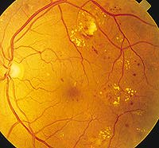
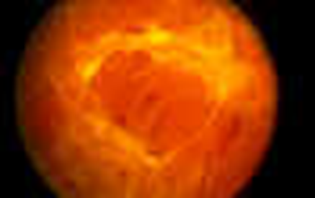
糖尿病眼底病变：水肿，出血

Slide 26
Thanks You

